Slide 1
Lesson Three
Food delivery and storage

Slide 2
Discuss
Have you ever received and accepted a food delivery?
What should you check for?
Notes:
What should you check for?
Delivery vehicle is clean
The delivery vehicle does not contain non- food items
Food should be free from obvious contamination and in good condition
Food must be within its best before or use by date
No evidence of infestation
Packaging must be undamaged
All high risk food has been delivered chilled or frozen
Temperature of the food in the delivery is correct – when checked with a thermometer.

Slide 3
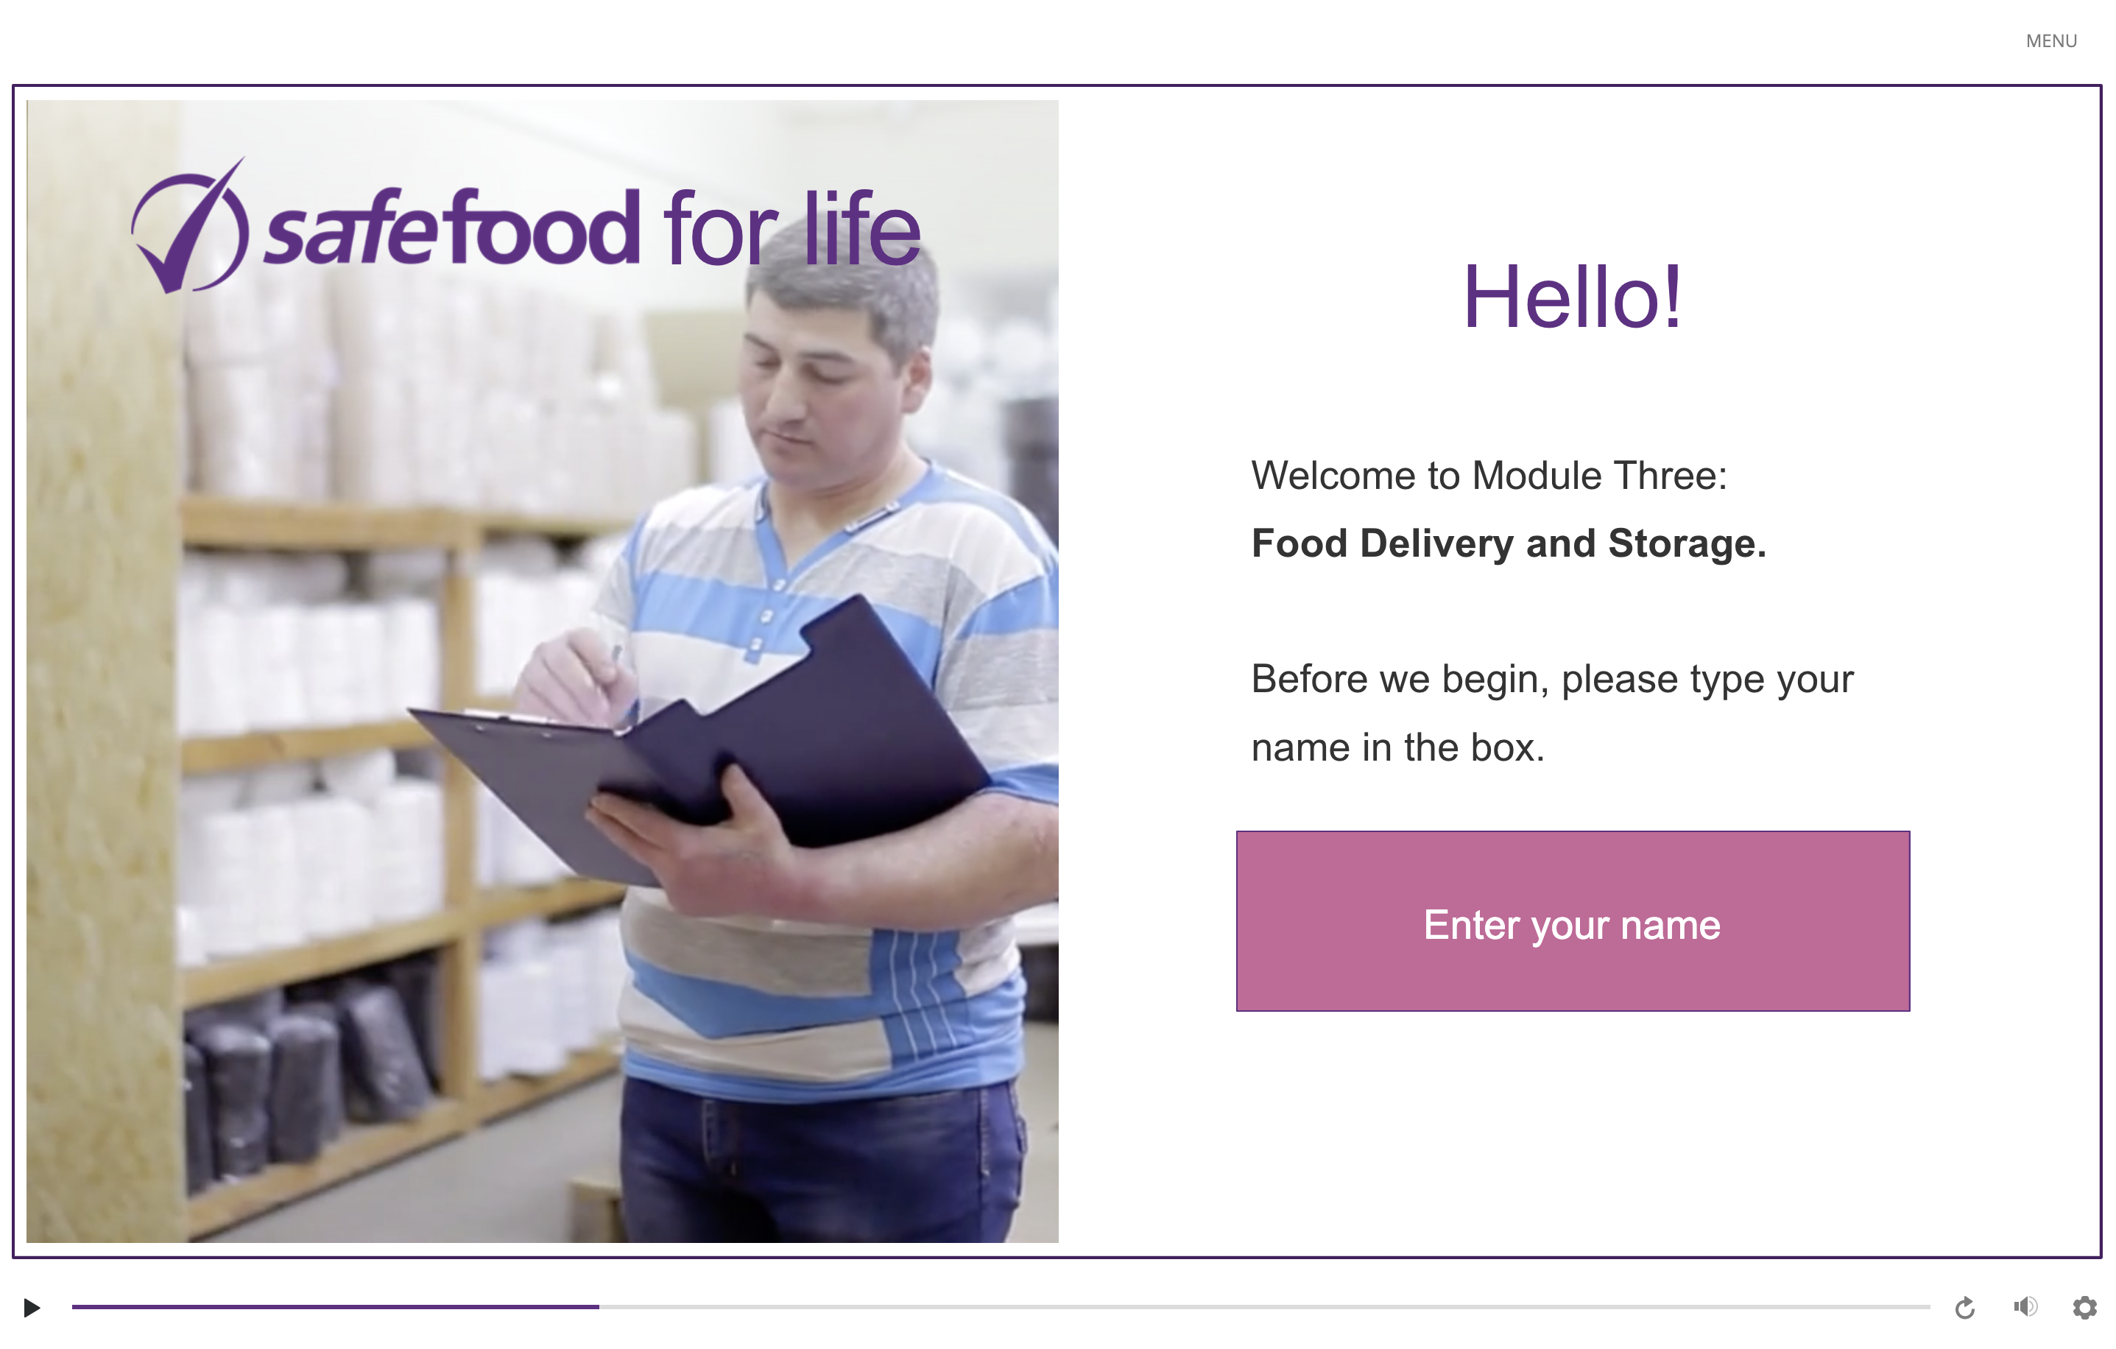
eLearning module

Slide 4
In class task
Use a thermometer and a chart to check the temperature in different areas of the kitchen. Check and record the temperature of:
The refrigerator
The freezer
The food cupboard
The room you’re in
Anything else suitable
Where would bacteria most likely multiply? What information does this tell us?
Notes:
Divide the students into pairs and provide them with a thermometer and a chart to record the results. The students should work in pairs to check the temperature in different areas of the home economics kitchen (or work individually at home). Ask the students to include a reading for the refrigerator, the freezer, the food cupboard and the general room temperature.
Get the students to carry out the activity. Discuss their results.
Check the temperature of different areas of a kitchen where food is stored and used.
The students should record the results carefully, suggesting the locations where bacteria would be able to multiply.
Discuss: What information does this tell us? We need to be careful not to leave food at temperatures where bacteria could multiply.

Slide 5
Homework task
Carry out a simple survey to see if your friends and family know how to store food in the refrigerator. Some sample questions to ask include:
How often should you check the temperature of the refrigerator?
Where should raw meat be stored?
Should food be covered or uncovered?
Is it OK to put hot food in the refrigerator?
Is it OK to store raw and cooked food together in the refrigerator?
Is it a good idea to keep the refrigerator as full as possible at all times?
Should you keep the door of freezer closed if there is a power cut?
Write up your results and summarise your findings in a conclusion.

